Slide 1

SQL Case Study 2 Human Resources

Slide 2
Questions
Find the longest ongoing project for each department.
Find all employees who are not managers.
Find all employees who have been hired after the start of a project in their department.
Rank employees within each department based on their hire date (earliest hire gets the highest rank).
Find the duration between the hire date of each employee and the hire date of the next employee hired in the same department.

Slide 3
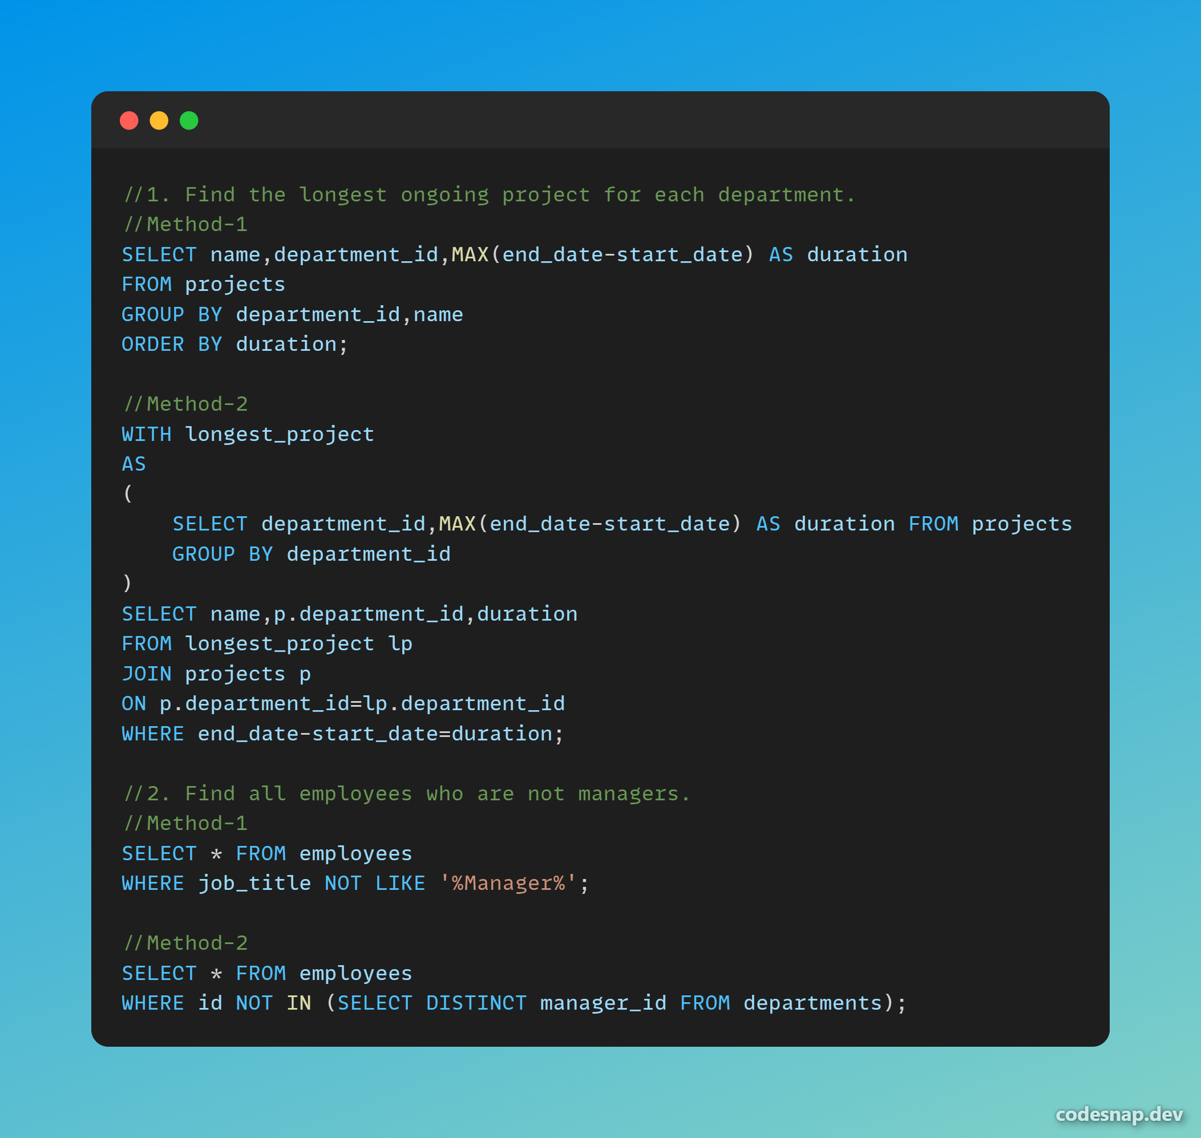

Slide 4
